Slide 1

Deloitte Pre Hire Training 2017
FOUNDATION TRAINING
Spring MVC

Slide 2
Spring 3 MVC
Introduction

Slide 3
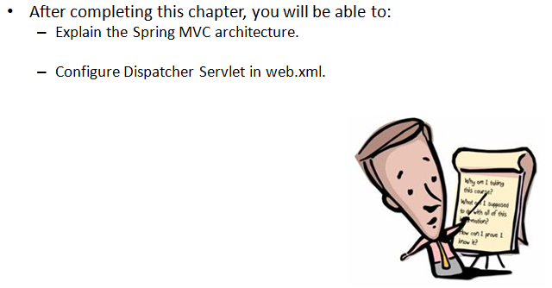
Objectives

Slide 4
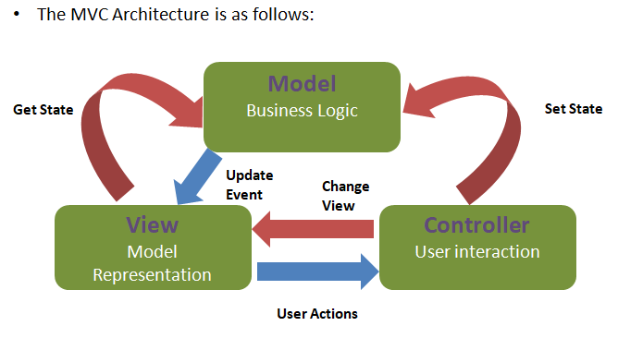
MVC Architecture Design

Slide 5
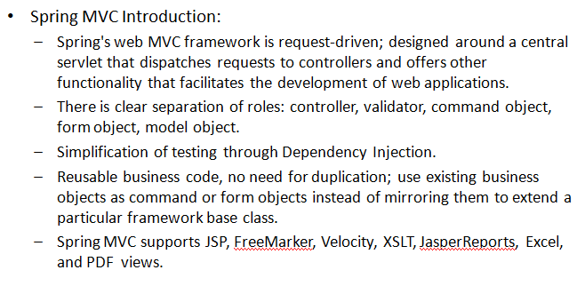
Spring MVC Introduction

Slide 6
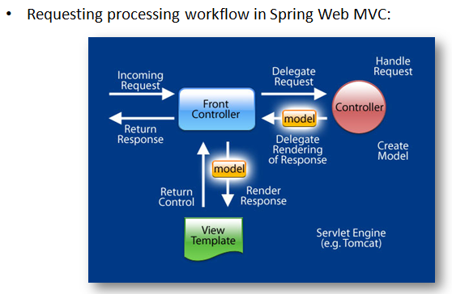
Request Life Cycle

Slide 7
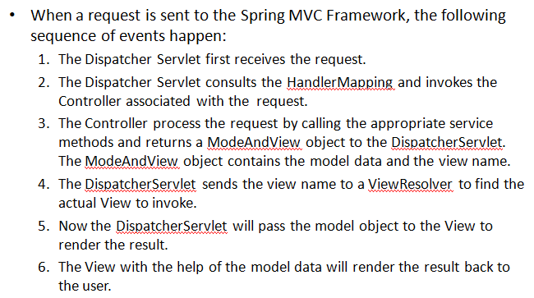
Request Life Cycle

Slide 8
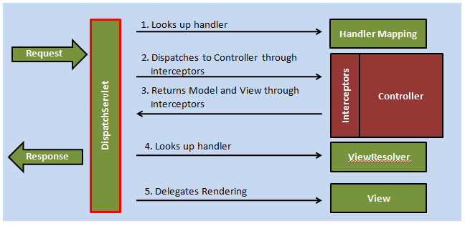
Introduction to Dispatcher Servlet

Slide 9
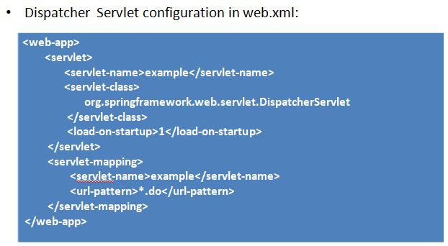
Configure Dispatcher Servlet in web.xml

Slide 10
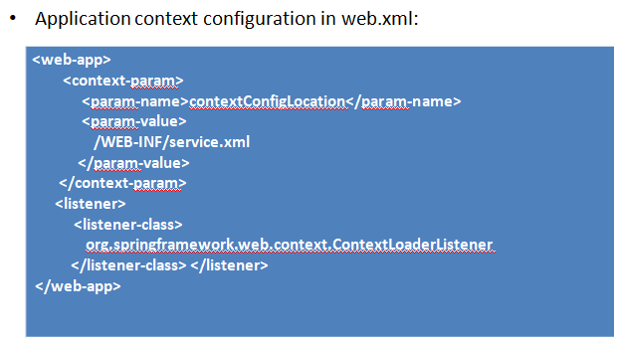
Configuring Application Context

Slide 11
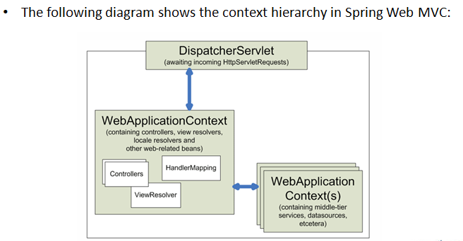
Context Hierarchy in Spring MVC

Slide 12
Demo
Demo on how to configure Dispatcher Servlet and application context.

Slide 13
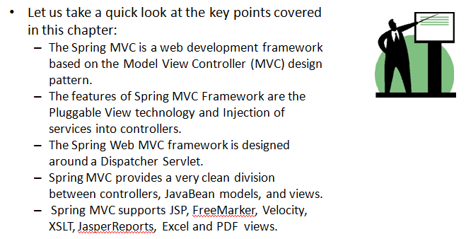
Summary

